Slide 1
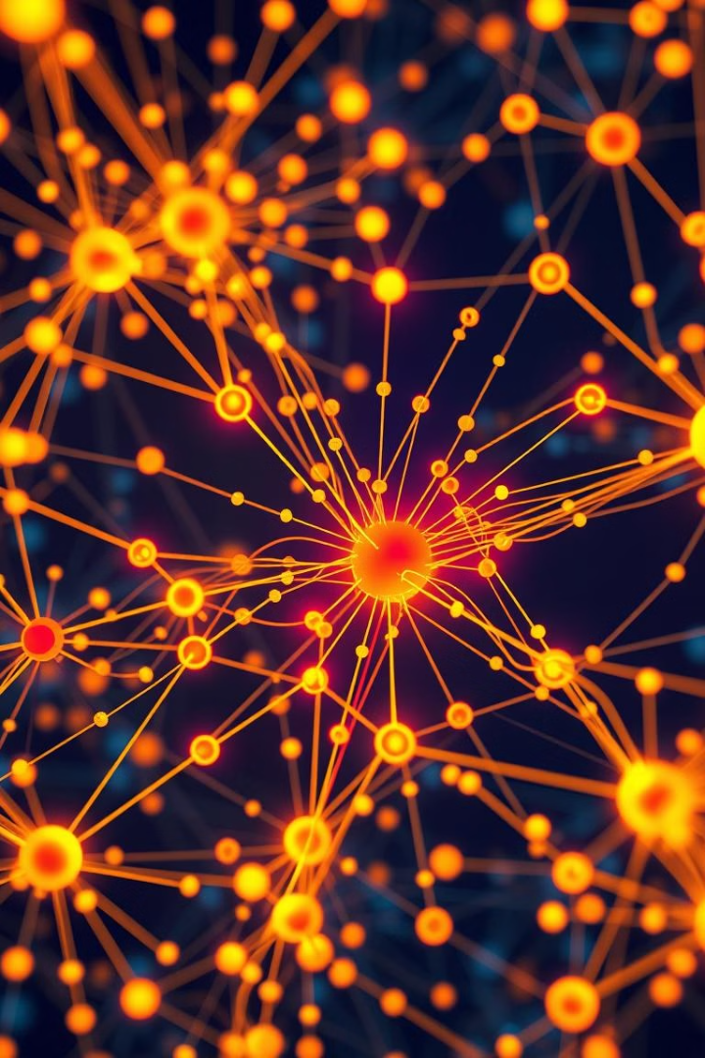
Disease Pattern Analysis System
Revolutionize disease surveillance and response with a cutting-edge system.
B Durga Prasad
192210023
Under the Supervision of
DR Arul Raja M

Slide 2
Challenges in Traditional Disease Monitoring
Data Silos
Manual Processes
Limited Insights
Information isolated across different institutions
Time-consuming and prone to human error
Difficulty identifying emerging patterns and trends

Slide 3

Benefits of Cloud-Based Platform
1
Scalability
2
Accessibility
Adapt to growing data volumes and user demands
Access data and tools from anywhere with an internet connection
3
Cost-Effectiveness
4
Security
Reduced infrastructure costs and operational overhead
Robust security measures to protect sensitive data

Slide 4
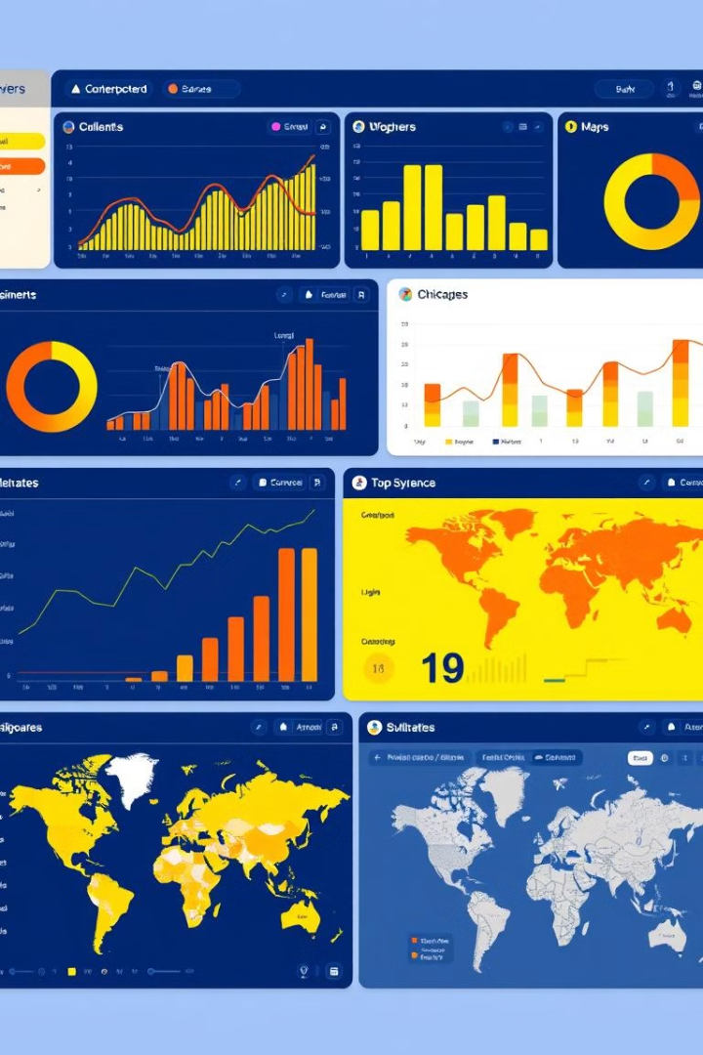
Key Features of the System
Data Collection
Data Integration
Real-time data from multiple sources
Unified view of disparate data streams
Data Visualization
Alert System
Interactive dashboards and reports
Notifications for critical events and outbreaks

Slide 5

Data Collection and Aggregation
1
Data Sources
Electronic health records, surveillance systems, social media
2
Data Standardization
Ensuring consistency and comparability
3
Data Storage
Secure and scalable cloud infrastructure

Slide 6
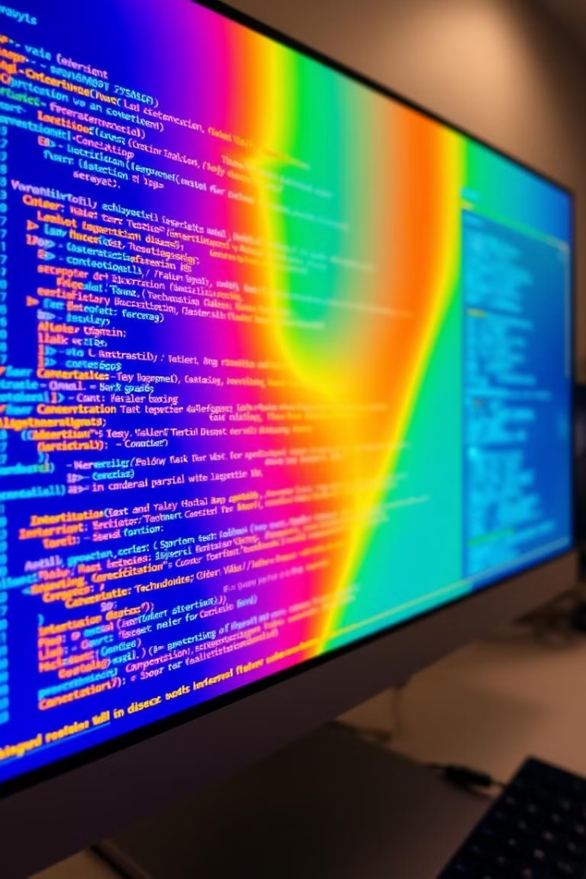


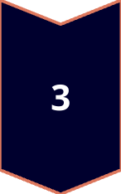
Advanced Analytics and Algorithms
Spatial Analysis
Mapping disease outbreaks and trends
Time Series Analysis
Identifying seasonal patterns and anomalies
Machine Learning
Predictive modeling and outbreak detection

Slide 7

Predictive Modeling and Forecasting
Model Type
Description
Regression
Predicting disease incidence
Time Series
Forecasting future trends

Slide 8
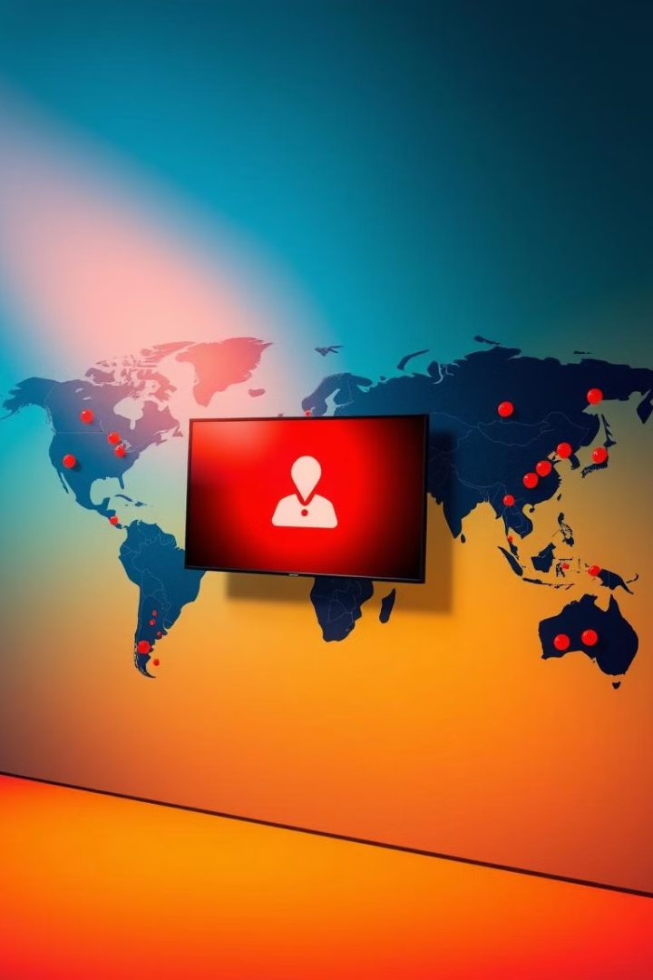




Early Warning and Outbreak Detection
Real-time Monitoring
Alert Thresholds
Continuous surveillance for suspicious patterns
Triggering notifications based on pre-defined criteria
Automated Notifications
Geographic Targeting
Prompt communication to relevant stakeholders
Focusing resources on high-risk areas

Slide 9
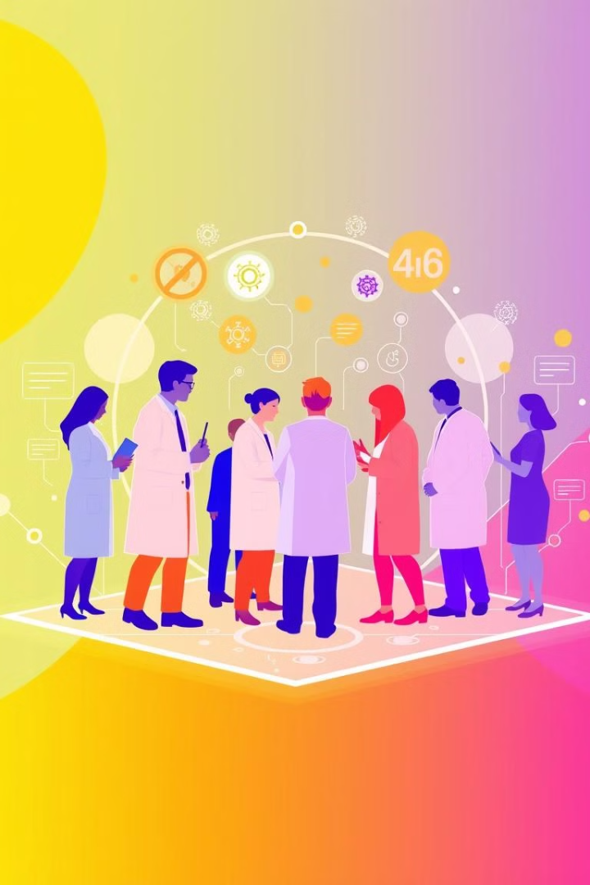
Conclusion and Future Outlook
Empower public health professionals with advanced tools for disease control.
Enhanced Predictive Modeling Improved accuracy through sophisticated algorithms.
Real-Time Data Integration:
Utilization of IoT devices and wearables for continuous health data collection.
Artificial Intelligence (AI) and Deep Learning:
Application of advanced AI techniques for deeper pattern recognition.

Slide 10


